Slide 1
Architecture Selection for API: Rest vs GraphQL
Team members:
Arsalan Imran (002344722)
Dan Luo (002352806)
Guan Wang (002341590)

Slide 2
Introduction:
The choice of API architecture can significantly impact the performance, scalability, and overall user experience of an application. The decision between Rest and GraphQL often poses a significant challenge.

Slide 3
Pros of GraphQL
Data fetching control
GraphQL provide better performance for amount of needed data, because it was designed to allow the client to ask for only the data it needs.
Using multiple data sources
Less http calls compared to rest which need more calls to access different entities. Graph can ask for data from multiple entities in one call
Alleviating bandwidth concerns:
Since GraphQL responds more precisely compared to rest api, it will save more bandwidth and is more suitable for small devices.
Rapid prototyping
Change can be easier, and system are more flexible. For example, if your UI changes, requiring either more or less data, it doesn’t have an impact or require changes from the server.

Slide 4
Pros of Rest
Complex queries
a REST API might be easier to design because you can establish multiple endpoints for specific needs, and you can fine-tune specific queries to efficiently retrieve the data. For graphQL, if you're not careful, a few big queries can bring your server down dramatically.
For simple tasks
Using GraphQL in a simple application is not recommended. For example, in an application that uses a few fields the same way each time, using GraphQL adds more complexity because of things like types, queries, mutators, resolvers, and higher-order components. It increase the respond time

Slide 5
Objective
Identify Use Cases: Identify specific use cases where REST or GraphQL architecture excels, which means evaluate the performance of each APIs under different categories and providing developers with practical guidance on architectural selection.
Metric Analysis: analyze key performance metrics such as average response times, throughput, data sent rate and data received rate for both REST and GraphQL architectures. The analysis of REST and GraphQL APIs will be done by its ability to handle increasing numbers of concurrent users and data requests.

Slide 6

What we did...
We compared rest and graphQL in mulitple ways:
We collected the dataset of 1500 rows of different rest and graphQL apis based on different categories(business areas) and compare the performance of rest and graph on catagorical as well as overall data .
We compare the performance of two similar crud base application built in rest and graphQL.
We studied how graphQL and rest api can work together to improve the performance of the system.
We also looked into latest research or trends in rest and graphQL architectures.

Slide 7

Data collections
We collect 150 rest apis and 150 graphQLs apis with 15 catagories(Animal, Art & Design, Business, Calendar, Development, Email, Finance, Game, Movie, Music, Security, Social, Transport, Weather)
Using jmeter tool to test apis with different users(1,20,50,100,1000)
for concurrency levels greater than or equal to 1000 users, none of the tested services were able to serve requests because the services were unavailable.

Slide 8
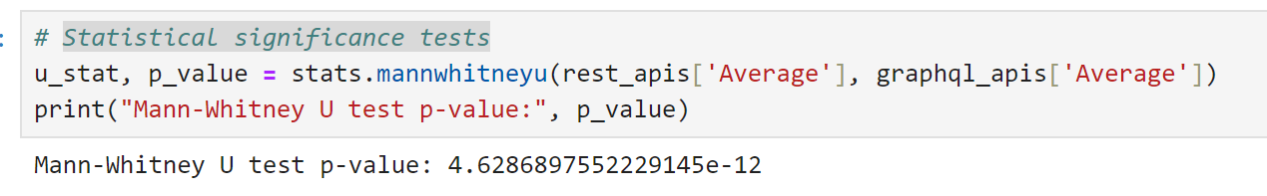
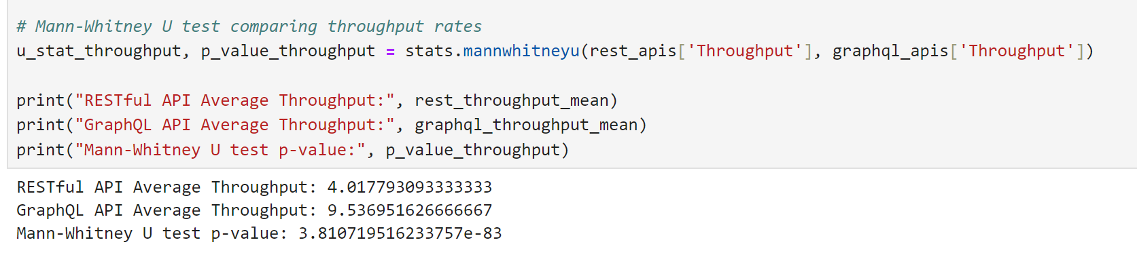
Statistical significance tests
Statistical significance tests of average respond time
Statistical significance tests of average throughput

Slide 9
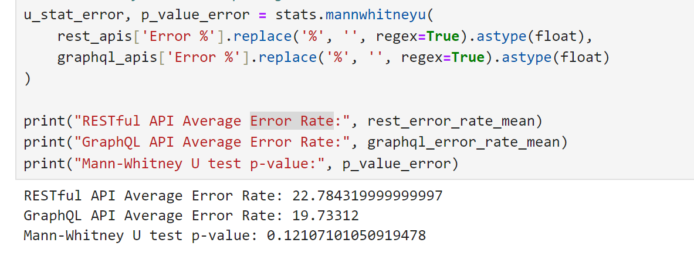
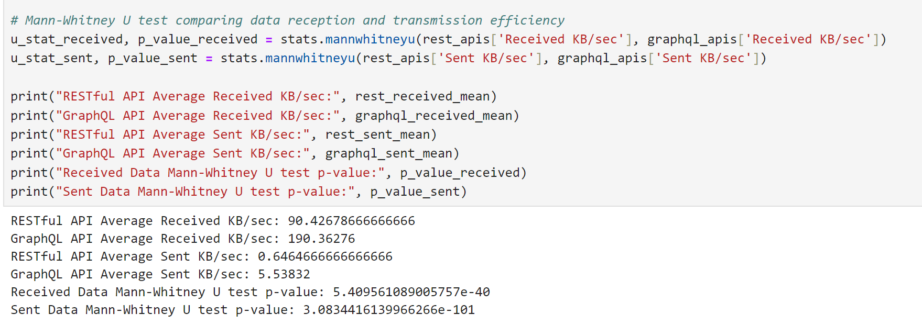
Statistical significance tests
Statistical significance tests of average Error Rate
Statistical significance tests of Average Received KB/sec and Average Sent KB/sec

Slide 10
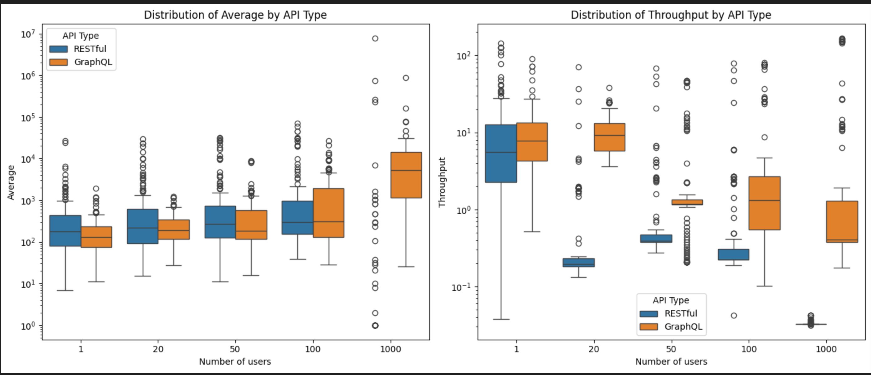
Apis Performance analysis

Slide 11
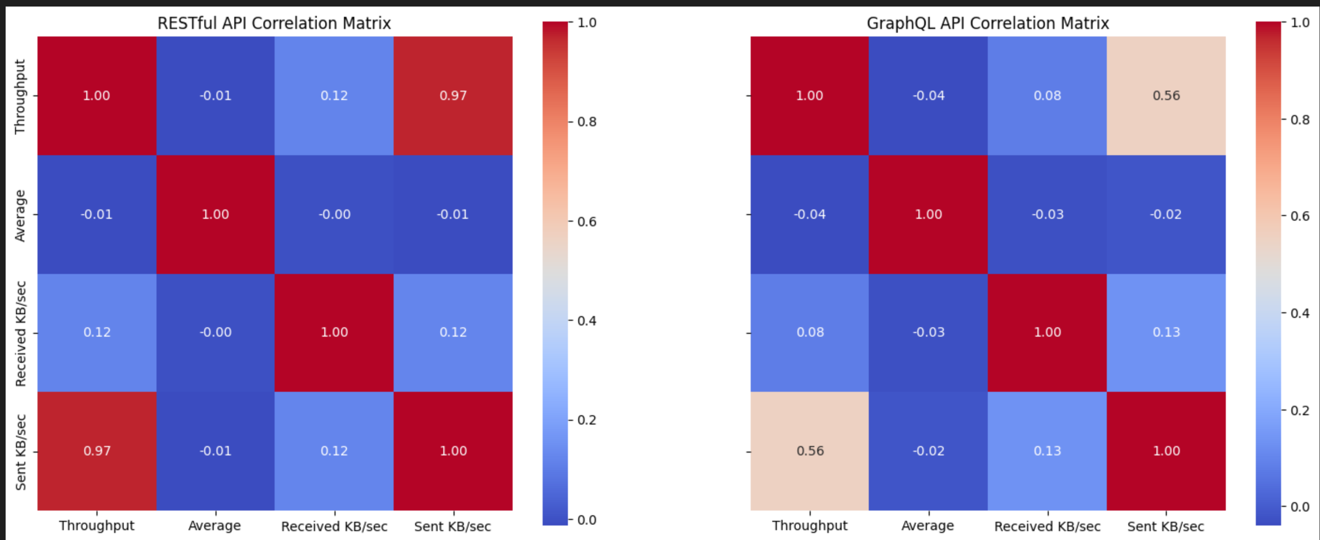
Apis Performance analysis:

Slide 12
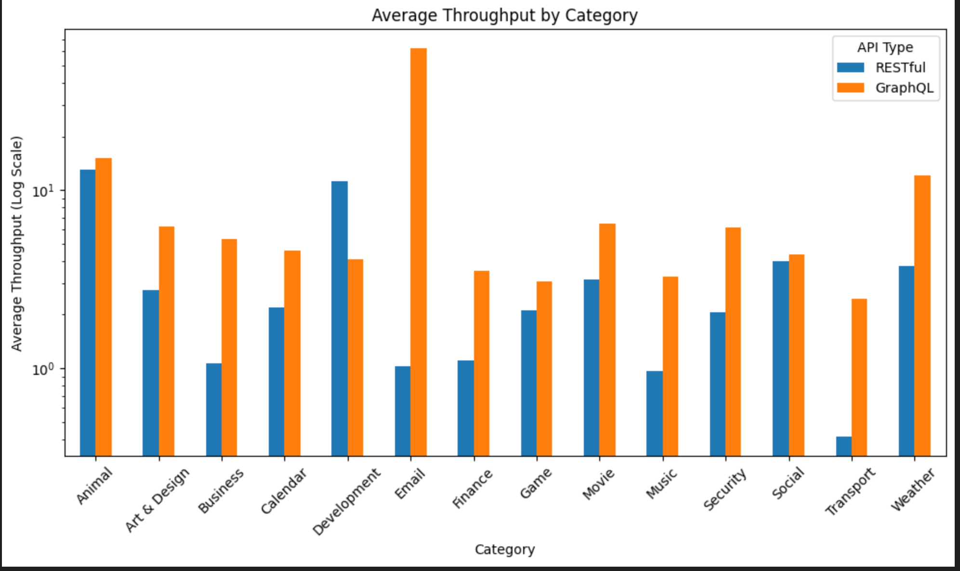
Apis Performance analysis

Slide 13
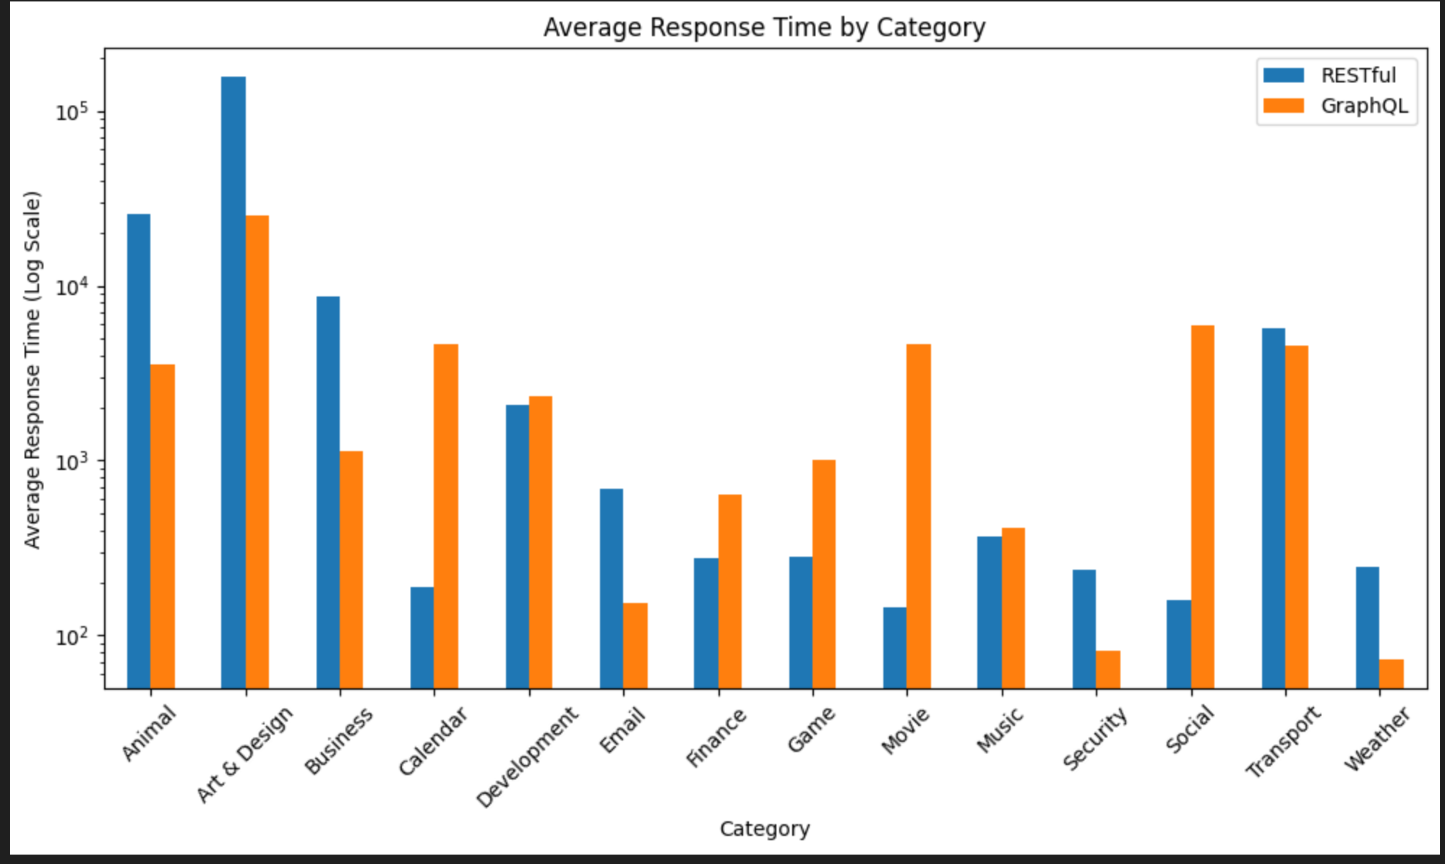
Apis Performance analysis

Slide 14
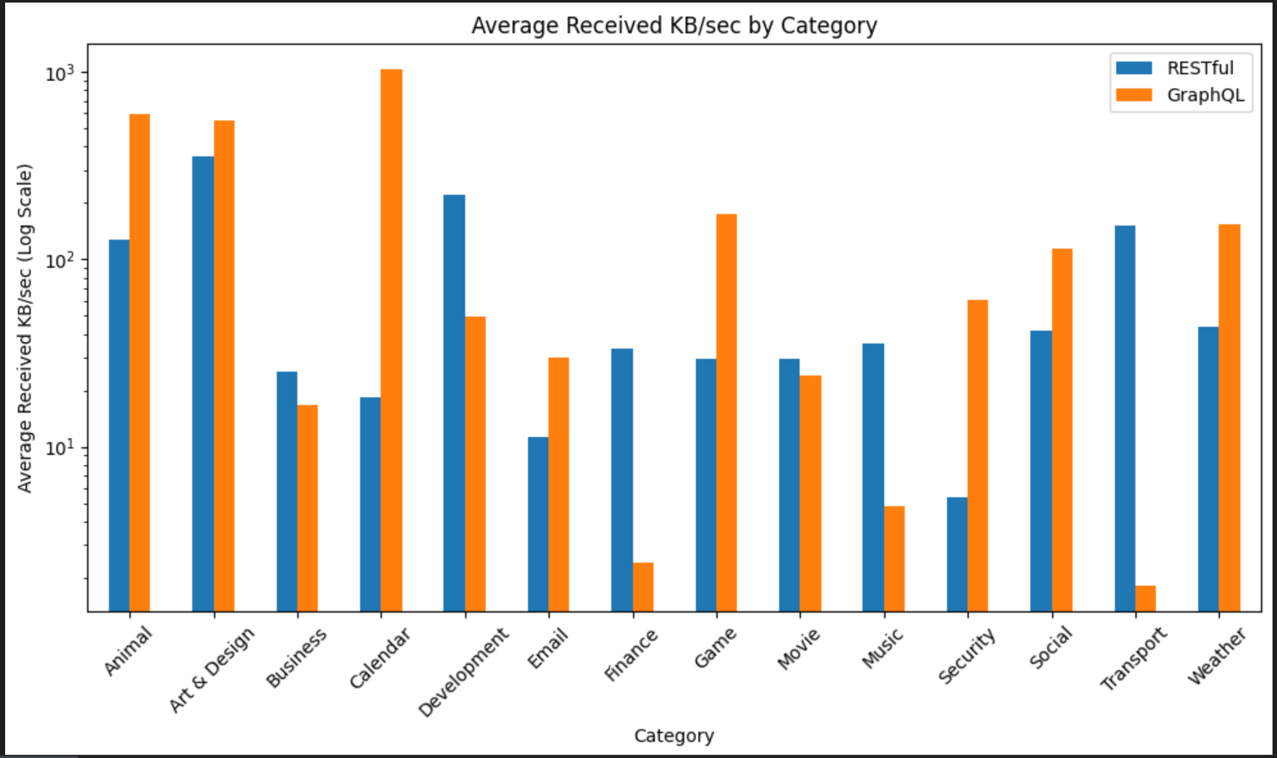
Apis Performance analysis

Slide 15
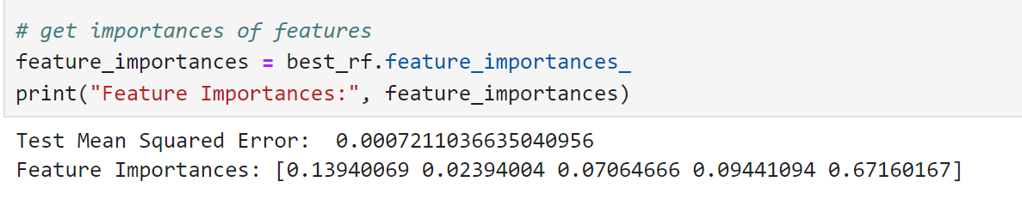
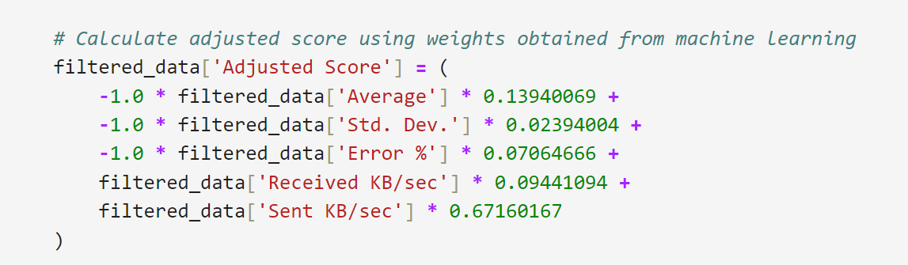
Api Performance analysis: modeling
RandomForest
Gridsearch

Slide 16
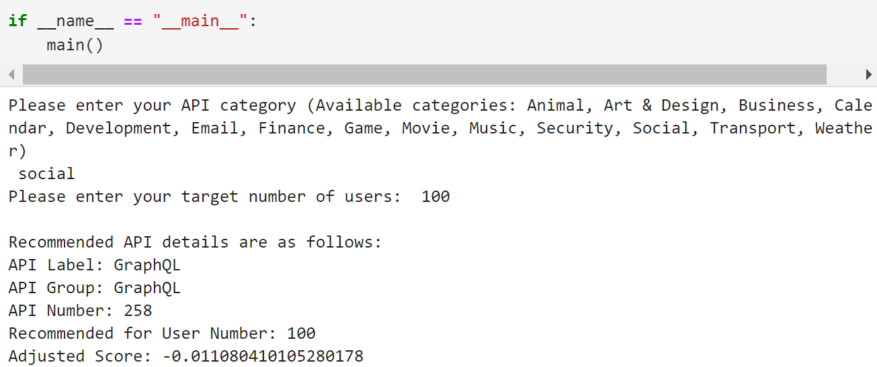
Predict the result
According to the model and function we build; we can predict and give the recommend Api for specific business area and user numbers. For instance, if there is a social media company who want to select Api and general have 100 users in the same time, we will suggest them choose the GraphQL api.

Slide 17

Conclusion of api performance test
the choice between REST and GraphQL should depend on the specific requirements of the application. For applications requiring high throughput, REST is preferable. However, for applications where efficient data retrieval and reliability are critical, GraphQL presents a more advantageous solution.

Slide 18

Rest Vs GraphQL:Crud Comparison of similar system.

Slide 19
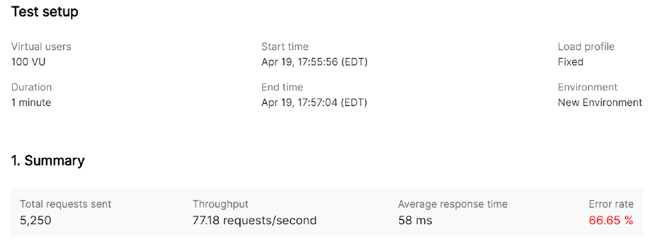
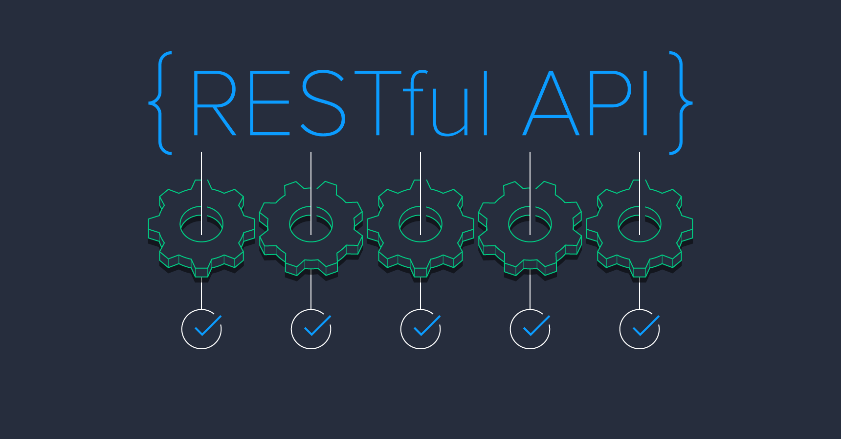
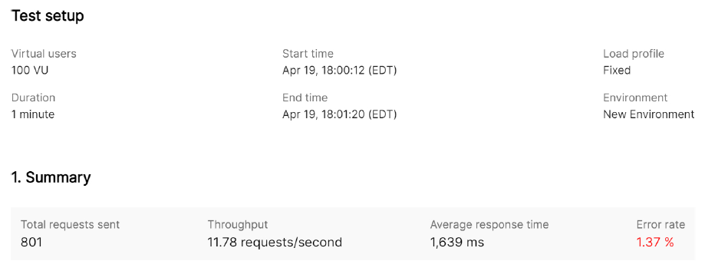
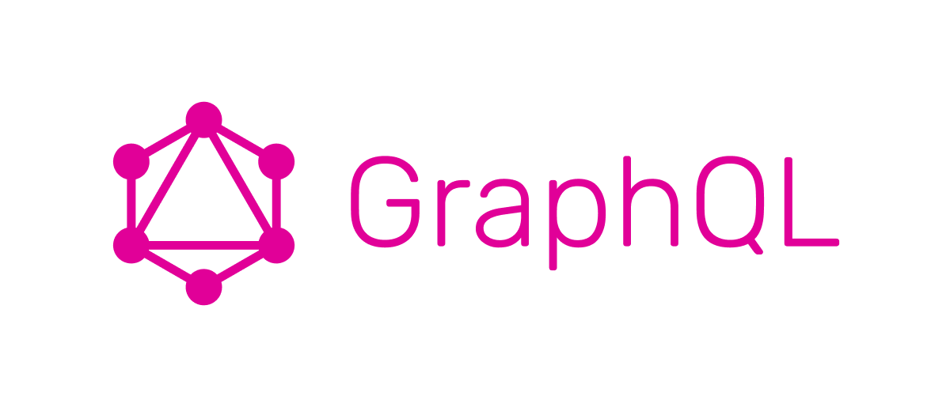

Slide 20
Comparing the two load tests based on the provided data:
1. Throughput:
- Rest Test: 77.18 requests per second
- Graph Test: 11.78 requests per second
The Rest had a significantly higher throughput compared to the second test. This suggests that the system was able to handle a larger volume of requests per second in the first test scenario.
2. Average Response Time:
- Rest Test: 58 milliseconds
- Graphql Test: 1639 milliseconds
The Graphql had a much higher average response time compared to the first test. This indicates that, on average, requests took significantly longer to process and respond to in the second test scenario.
3. Error Rate:
- Rest Test: 66.65%
- Graph Test: 1.37%
The error rate in the Rest test was substantially higher compared to the Graphql test. While the first test encountered errors in approximately 66% of requests, the second test had a very low error rate of only 1.37%.
Based on these comparisons:
- The Rest test, despite having a higher throughput, suffered from a high error rate and a relatively low average response time.
- The Graphql test had a lower throughput but achieved a significantly lower error rate, indicating better reliability, and a slightly higher average response time, suggesting potential performance optimization opportunities.
Overall, while the first test demonstrated higher throughput, it also experienced a higher error rate and may require optimization to improve reliability and response times. The second test, despite lower throughput, showcased better stability with a minimal error rate, albeit with longer response times, indicating a more robust system under load.

Slide 21
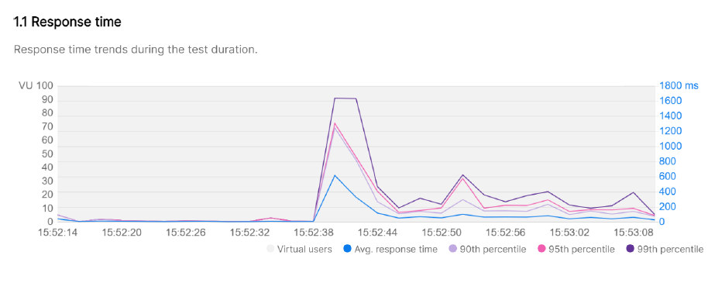
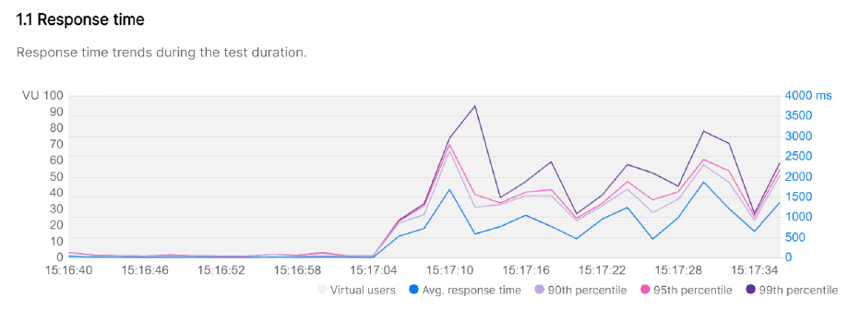

Slide 22
Comparing the last two response time graphs:
1. Response Time Trend:
Rest : The response time generally increases as the number of virtual users (VU) rises, showing a linear relationship between VU and response time.
Graphql: Response time also increases with more VUs, but the trend appears to be less linear, with some fluctuations and plateaus in response time.
2. Response Time Stability:
Rest : Despite fluctuations, there is a clear overall trend of increasing response times with increasing VUs.
Graphql : Response times fluctuate more prominently, indicating potential variability in system performance under different load conditions.
3. Scalability Insights:
Rest: Shows a more predictable scalability pattern, with response time consistently rising as VUs increase.
Graphql: Demonstrates a less predictable scalability pattern, with response time exhibiting more variability and potential performance bottlenecks.
Rest indicate an increase in response time with higher VUs, Graph 1 suggests a more predictable scalability trend.
GraphQL highlights potential performance variability and optimization opportunities.

Slide 23
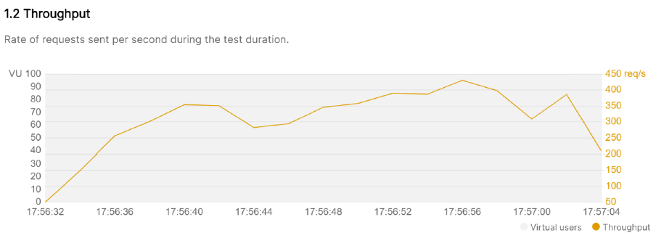
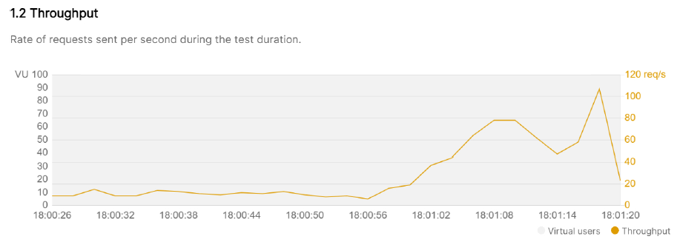

Slide 24
Rest: the throughput graph demonstrates the system's capacity to handle increasing loads effectively, with stable and consistent rates of requests sent per second across different virtual user levels.
the throughput graph for the GraphQL test demonstrates the system's capacity to handle increasing loads up to a certain point, beyond which scalability limitations or performance constraints may impact throughput rates
Overall, the REST API appears to handle the load more steadily compared to the GraphQL API, which shows more variability in its throughput.

Slide 25
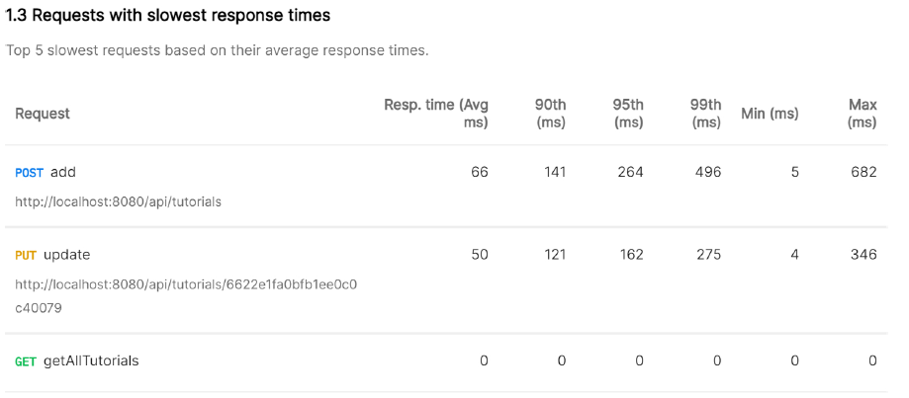
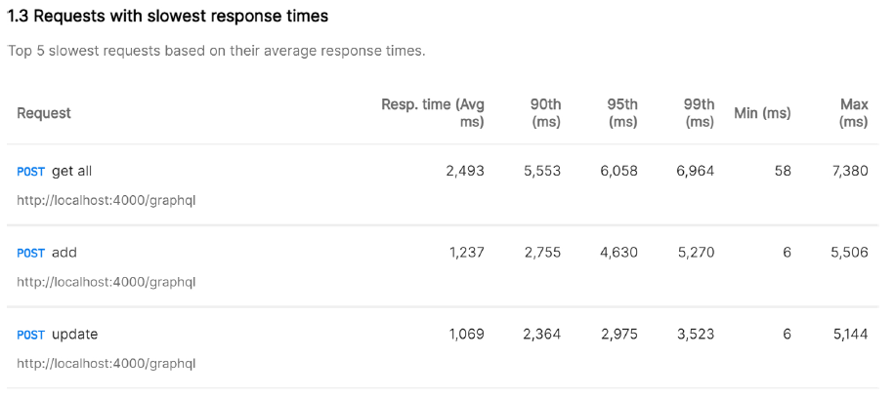

Slide 26
REST API:
The slowest response time for the POST add request is 682 ms.
For the PUT update request, the slowest response time is 346 ms.
GET getAllTutorials has a response time of 0 ms
GraphQL API:
The slowest response time for the POST get all request is 7380 ms.
POST add exhibits a slowest response time of 5506 ms.
POST update has a slowest response time of 5144 ms.
Comparing the two:
The slowest response times for GraphQL endpoints are significantly higher than those for REST endpoints.
GraphQL APIs generally exhibit higher variability and longer tails in response times compared to REST APIs.
The slowest response times for GraphQL endpoints are above 5 seconds, whereas the slowest response times for REST endpoints are generally below 1 second.
In summary, based on the slowest response time data, GraphQL APIs appear to have longer tails and higher variability compared to REST APIs.

Slide 27
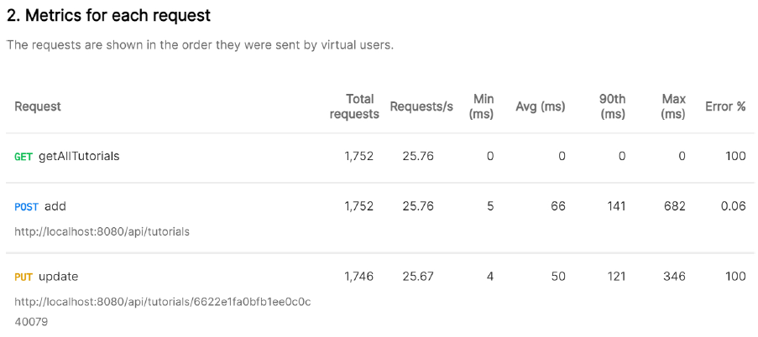
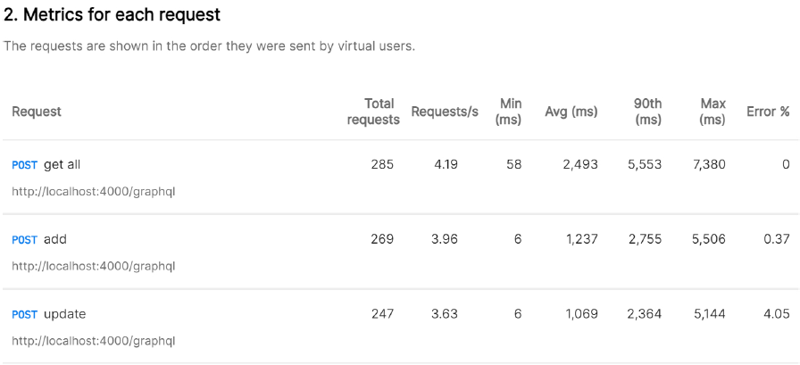

Slide 28
Insights: REST
GET getAllTutorials shows all requests having a response time of 0 ms, indicating a possible issue or misconfiguration. Needs Changes in code to handle load.
POST add has the highest maximum response time among the requests, reaching 682 ms.
PUT update also exhibits a high maximum response time of 346 ms.
Insights: GraphQL
POST get all has the highest maximum response time among the requests, reaching 7,380 ms, indicating potential performance issues.
POST add and POST update have similar maximum response times, but POST add has a slightly higher 90th percentile response time.
POST update has the highest error rate among the requests, indicating potential issues with this endpoint.

Slide 29
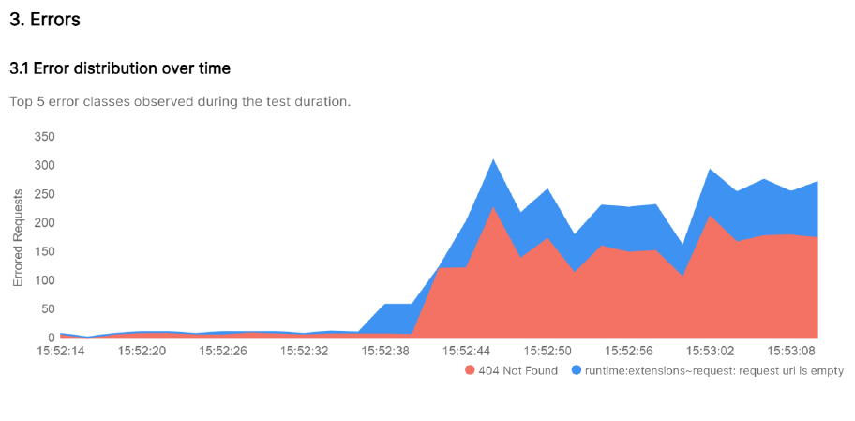
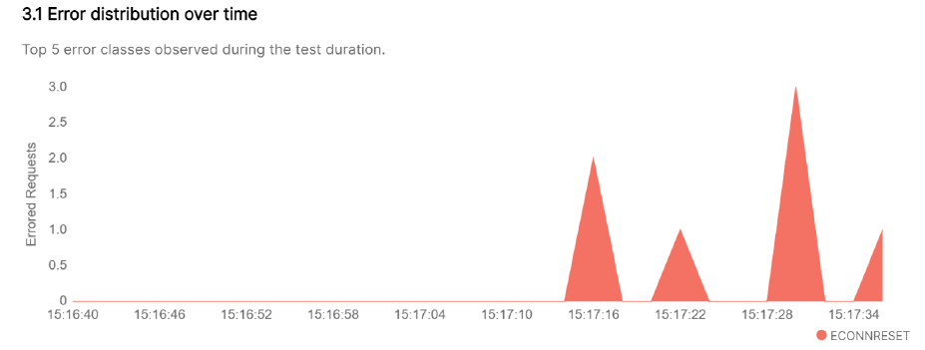

Slide 30
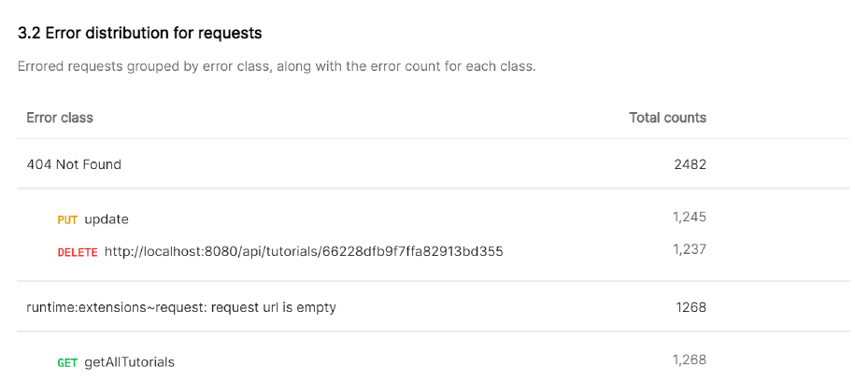
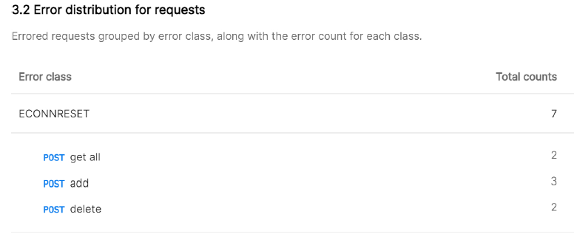

Slide 31
ECONNRESET: It typically indicates that the connection was reset by the peer during the transaction, suggesting issues with the network or server connectivity.
runtime:extensions~request: request url is empty: It suggests issues with requests where the URL is empty or missing
404 Not Found: This error occurred 2,482 times, indicating that there were many requests for resources that could not be found. This could be due to incorrect URLs or missing resources on the server.

Slide 32

Conclusion of Crud Comparison
Rest is better when it comes crud-based applications that requires good response time and higher throughput.
GraphQL tends to be more reliable with less errors.

Slide 33
Latest research and trends: performance test study
GraphQL is not a solution to eliminate all problems associated with API implementation. Performance bottlenecks can occur, and the main causes can be difficult to identify. Nevertheless, it may be less costly to maintain and evolve applications and APIs in GraphQL.
It is important for testing professionals to work closely with GraphQL API developers to implement appropriate tracking mechanisms and create performance tests that go beyond measuring simple requests and response time intervals between client and server.
Resource:REST or GraphQL? A Performance Comparative Study(Migrate to GraphQL)(Universidade Federal do Pará Belém, PA, Brasil)

Slide 34
Latest research and trends: Cost
The research ask graduate and undergraduate students to implement rest and graphQL apis of github, to test the implementation time and challenges. Results are as follows:
For different query types the median implementation time was higher when the tasks were implemented in REST.
We also observe that GraphQL requires less effort even for developers that have no previous experience which this technology. Which means experts in REST APIs can also write GraphQL queries with less effort.
Most of them related that the main benefit of GraphQL is the tool support provided by GraphiQL, e.g., auto complete feature. Another benefit is a better syntax to understanding the code and less effort to specify parameters.

Slide 35
Latest research and trends: Migration tool
There are a few tools and libraries available that can help you automatically convert REST APIs to GraphQL, like Apollo Federation, Prisma GraphQL Nexus, GraphQL Code Generator, Hasura and PostGraphile.
These tools can help streamline the process of converting REST APIs to GraphQL by automating the generation of GraphQL schemas, resolvers, and client-side code. However, keep in mind that automatic conversion may not always produce the most optimal GraphQL schema, and some manual adjustments or customization may be necessary depending on your specific requirements and use cases.

Slide 36
Latest research and trends: integration
Integrating REST and GraphQL leverages the best of both worlds:
REST's simplicity and widespread adoption for basic data retrieval and manipulation
GraphQL's flexibility and ability to efficiently fetch complex data structures with a single request.
This hybrid approach empowers developers to design APIs that cater to diverse application requirements, optimizing performance and developer experience simultaneously. By strategically choosing between REST and GraphQL for different parts of an application, developers can create more scalable, maintainable, and user-friendly APIs.

Slide 37
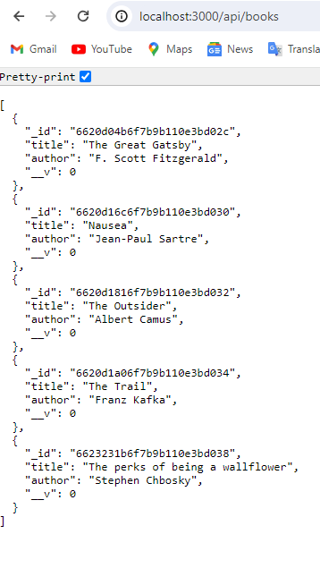
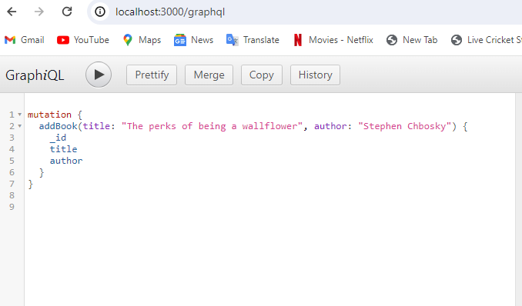
Integration of rest and graph

Slide 38

Reference
Comparison of REST and GraphQL web technology performance Porównanie wydajności technologii webowych REST i GraphQL Mateusz Mikuła*, Mariusz Dzieńkowski Department of Computer Science, Lublin University of Technology, Nadbystrzycka 36B, 20-618 Lublin, Poland
REST vs GraphQL: A Controlled Experiment Gleison Brito∗, Marco Tulio Valente∗ ∗ASERG Group, Department of Computer Science (DCC), Federal University of Minas Gerais, Brazil {gleison.brito, mtov}@dcc.ufmg.br
https://www.apollographql.com/
Resource:REST or GraphQL? A Performance Comparative Study(Migrate to GraphQL)(Universidade Federal do Pará Belém, PA, Brasil)

Slide 39
Thank you!

